Slide 1
“Always code as if the guy who ends up maintaining your code will be a violent psychopath who knows where you live.”
Rick Osborne

Slide 2
Code Reviews
Manuel Huber

Slide 3

Peer Reviews
Your
a failure
*You’re

Slide 4


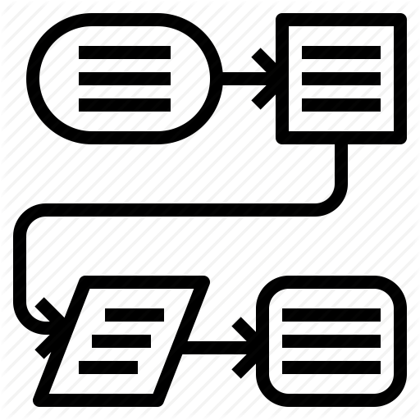

win hearts & minds
set goals
define process
Do it!

Slide 5
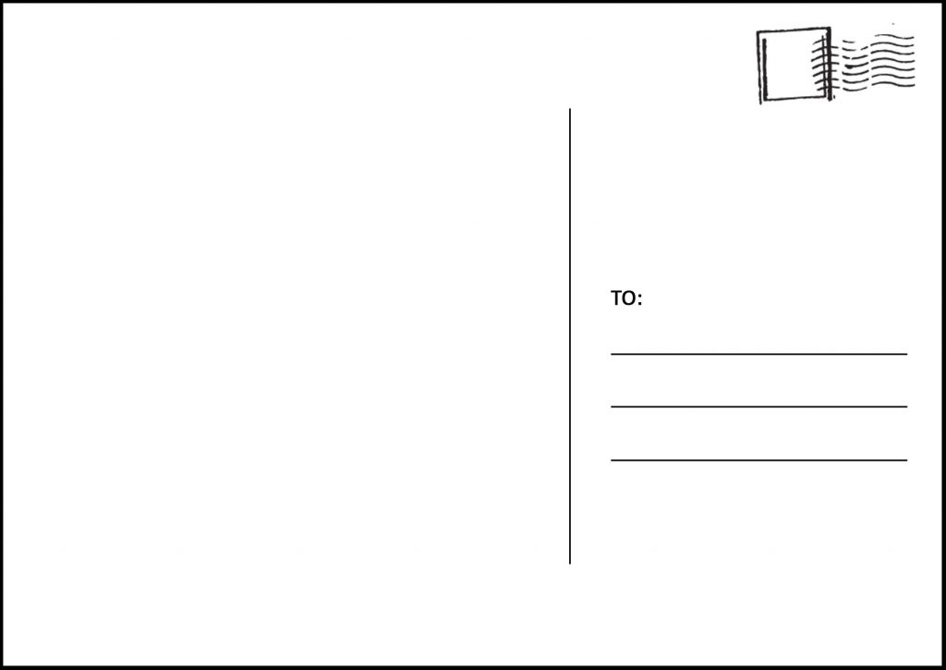

R.I.P
Software Inc.
Hochschulstraße 1
83024 Rosenheim
Greetings from Asia!
Love Dani ♥

Slide 6


Your fault!

Slide 7
Benefits for developers
Improved code quality → less refactoring
Less bugs → less fixing
Knowledge transfer
Shared Ownership & responsibility
Motivates to write better code

Slide 8
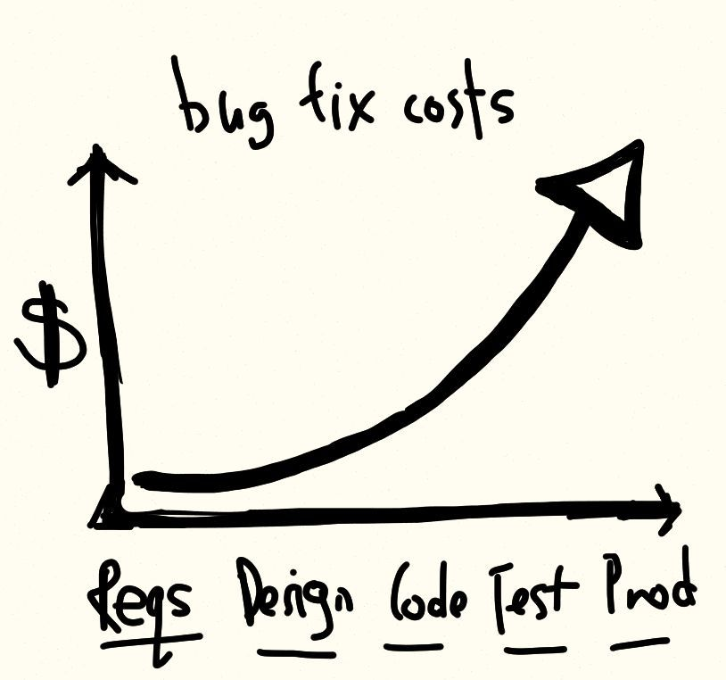

Slide 9
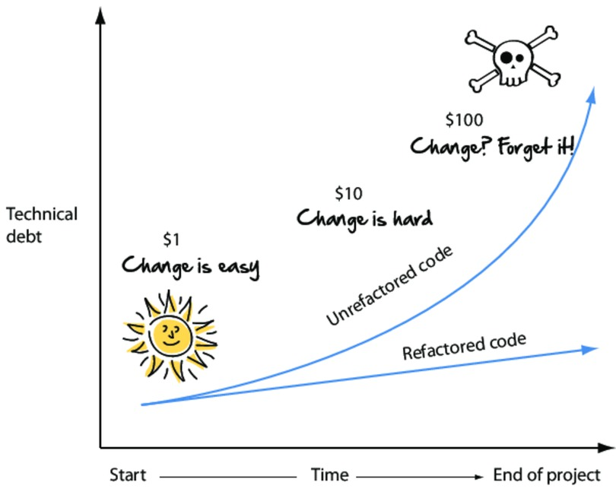

Slide 10
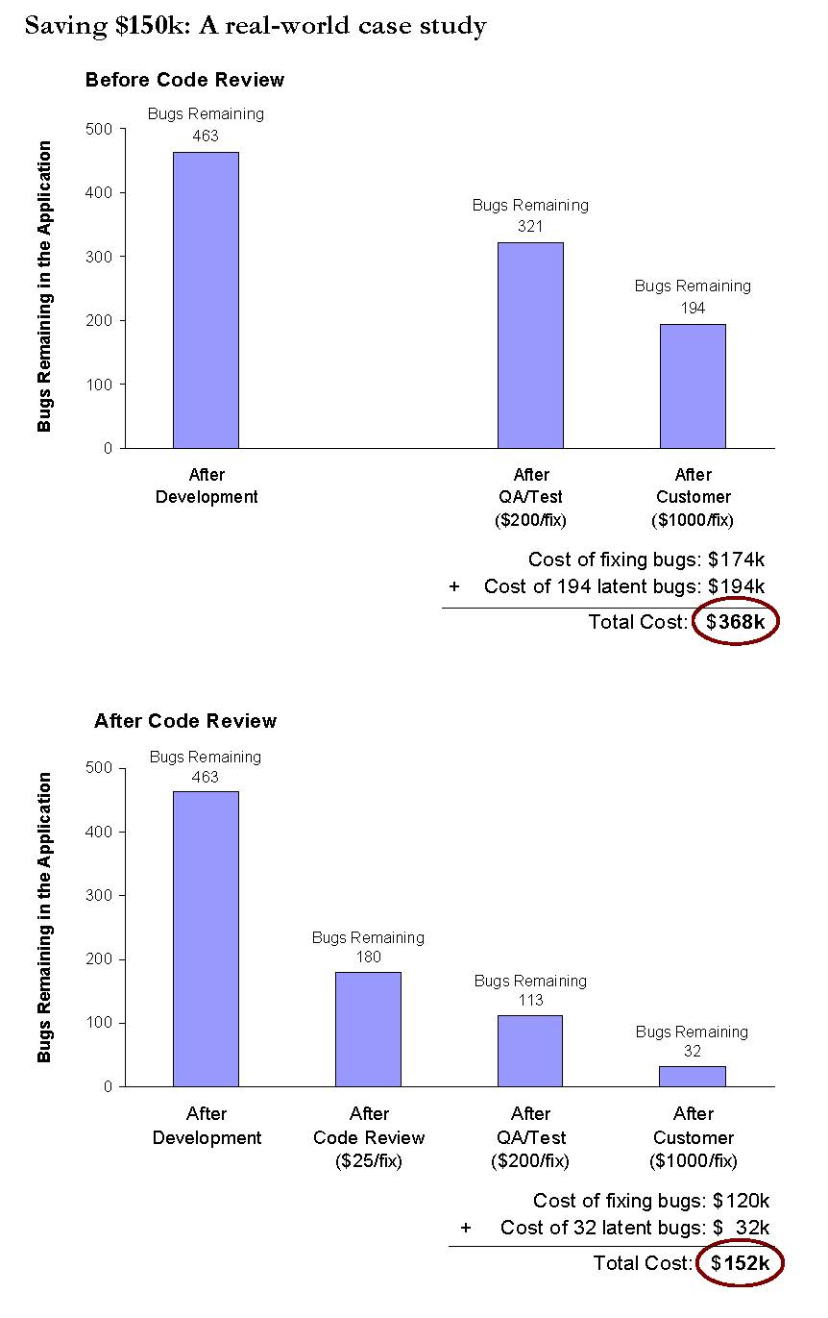
Case study: 10k loc – 10 devs
Without code reviews
With code reviews
Source: “The Best Kept Secrets of Peer Code Review” by Jason Cohen, Steven Teleki & Eric Brown

Slide 11
More Studies…
AT&T sub-organization (200 people) introduced reviews and reported:
14% increase in productivity
90% decrease in defects
1 Team built 11 programs (5 without reviews, 6 with reviews)
Without review: Average of 4.5 errors per 100 loc
With reviews: Average of 0.82 errors per 100 loc
Reviews cut the errors by over 80 percent
Source: “Code Complete” by Steve McConnell

Slide 12
Benefits for managers / customers
Improved code quality → Cheaper to maintain / expand
Less bugs → Faster & cheaper releases
Reduces “bus factor”
Makes onboarding developers easier
Improved transparency about project

Slide 13
Typical objections
“It slows us down” / “It’s too expensive”
It’s time/money well spent (quality is never free)
It saves time/money in the long run
“It causes friction between developers”
Overcome “The ego”. Even bestselling authors have at least 1 proof reader
Learn how to properly comment on code (don’t criticize but discuss)

Slide 14
Audit style
Exhaustive
Expensive
Disruptive to workflow

Slide 15
Over-The-Shoulder Walkthrough
Exhaustive
Expensive
Disruptive to workflow

Slide 17


